Slide 1



Slide 2
What is ITHF
One of 77 Rotary Fellowships
Consists of Rotarian members & their partners as well as alumni of all Rotary Foundation programs
Functions independently of RI by having its own rules, dues and administrative structure
Members share a common interest in travel and hosting
Established in 1990, ITHF is one of the largest & most active Rotary Fellowships
Served by a President, Administrator, Treasurer, Secretary, Web-master, Newsletter Editor, Director of Promotions, Director of Membership,4 Regional Vice Presidents and 35 Area Vice-Presidents

Slide 3
What are Rotary Fellowships
Consist of members who share a common interest in recreational activities, sports, hobbies or professions;
Expands skills, fosters vocational development and enhances the Rotary experience
Helps participants make lasting friendships outside their own club, district or country
Advances Rotary’s public image and identity

Slide 4
Rotary Fellowship History
Rotary Fellowships began informally in 1928 when Rotarians with a shared interest in Esperanto joined together.
In 1947, Rotarian boat enthusiasts called themselves the International Yachting Fellowship of Rotarians.
Fellowships (77) include Home Exchange, Cycling, Cruising, Recreational Vehicles, Skiing, Singles, Golf, & Wine appreciation

Slide 5
How does the ITHF function?
Once approved, member information is listed in the on-line directory & Roster of Members
Members planning travel refer to the on-line directory to identify ITHF members living in that area.
Contact prospective hosts at least 30 days prior to the intended travel.
Prospective hosts consent to “connections” with visitors subject to their convenience.
Details of the visit are worked out between the members. Visits can be overnight, for a meal or for a day trip or a special occasion.

Slide 6
How does it differ from Rotary Friendship Exchange?
Rotary Friendship Exchanges are arranged on a District to District basis and usually involve teams of Rotarians and their partners who travel with pre-arranged itineraries.
ITHF “connections” are self paced, open-ended, subject to individual
preferences and coincide with business or pleasure travel.

Slide 7
Who can be a Member?
An Rotarian, single or with a partner who enjoys travel and hosting
Apply for membership and pay on-line through the ITHF website; US$ for 1 year; US$75 for 3 years.
Members are encouraged to enhance their Profile information about themselves & the area where they live, include photos and indicate where they want to visit.

Slide 8
Member’s obligation
Membership implies the desire to accommodate ITHF visitors; however, such connections are always subject to the host's convenience.
Respond to all inquiries
Protect directories from unauthorized use.
Complete personal on-line profile & keep it current
Renew membership subscription on-line

Slide 9
Benefits of Membership
Membership in a worldwide association devoted to promoting cultural exchange, sharing and fellowship.
Personal listing in the secure Members’ Area on the website and inclusion in the ITHF Roster of Members which is updated quarterly
Quarterly “Connections” newsletters
One year free subscription for contributing an article that is used in the quarterly “Connections”.

Slide 10
Benefits contd.-
Pre and Post-Convention Tours and trips to other special destinations. Trips are organized by the Tour Committee
Access to the Members’ Area of ITHF’s website providing details of upcoming tours, complete directory listings including new members, newsletters, and more.
Volunteer opportunities to serve on committees or in the ITHF “Buth” at RI Conventions.
ITHF Facebook

Slide 11
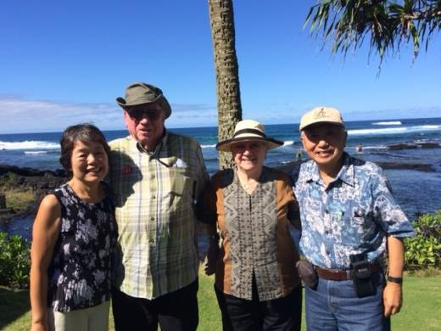
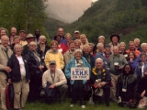
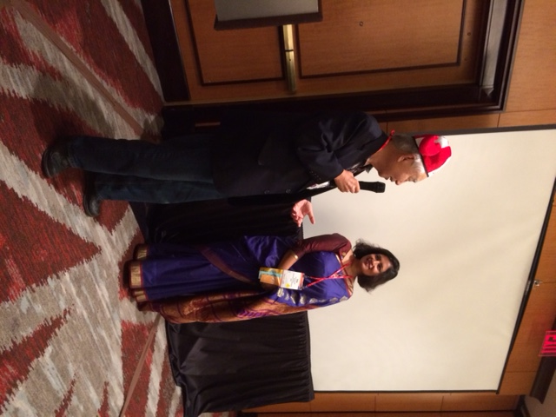
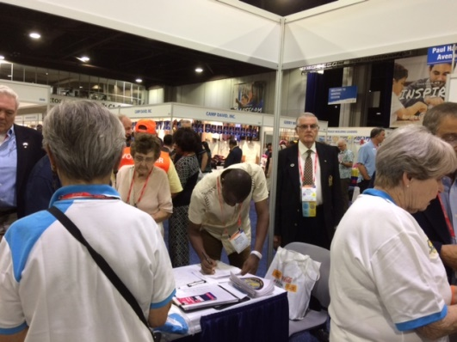
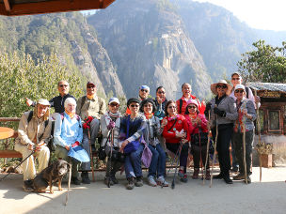
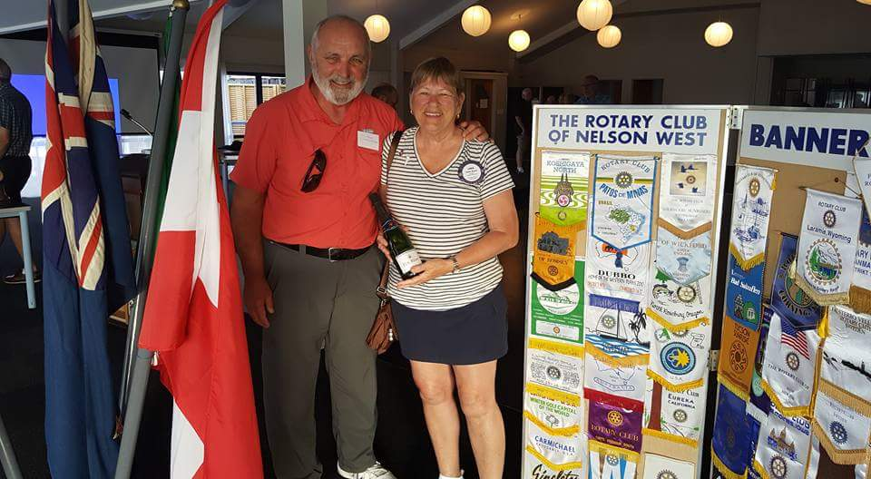
Connections
From Nelson, Canada to Hilo Hawaii – drop in and visit ITHF friends while on shore from a cruise
From around the world – participate in Pre & Post Convention Tours
From Hilo, Hawaii & Bagmati, Nepal – share a moment at the AGM Breakfast Meeting
From California, Australia & Maine – volunteer at the Buth at the RI Convention
From Richland, WA to Nelson, NZ – make friends through home stay & visit clubs
From around the world – participate in special tours such as the Nepal & Bhutan trip 2017

Slide 12
ITHF Membership
As of June, 2017, there were 1,086 paid members of ITHF. These listings represent approximately 1,800 Rotarian and partner members.
ITHF has members in approximately 55 countries.

Slide 13
Membership Country wise
Argentina 5
Australia 88
Bahamas 0
Bangladesh 5
Belize 1
Benin 0
Bermuda 0
Botswana 1
Brazil 29
British Virgin Is. 1
Canada 58
Cayman Islands 0
Chile 0
China 0
Columbia 1
Cote D’Ivoire 0
Croatia 1
Denmark 6
Dominican Republic 1
Ecuador 2
Egypt 0
England 28
Finland 3
France 5

Slide 14
Membership Country wise
Gabon 0
Germany 3
Ghana 0
Guatemala 1
Hong Kong 0
India 63
Indonesia 2
Israel 0
Italy 1
Jamaica 4
Japan 4
Kenya 2
Korea 3
Malaysia 4
Mexico 3
Mongolia 1
Nepal 13
Netherlands 2
New Zealand 23
Nigeria 10
Norway 3
Pakistan 2

Slide 15
Membership Country wise
Peru 0
Philippines 4
Poland 0
Puerto Rico 0
Romania 3
Russia 12
Rwanda 1
Samoa 1
Scotland 3
Senegal 1
Serbia & Montenegro 0
Singapore 1
South Africa 6
Spain 3
Sri Lanka 5
Sweden 5
Switzerland 2
Taiwan 90
Thailand 3
Trinidad & Tobago 0
Turkey 3
Uganda 6
Ukraine 1
United Arab Emirates 1
United States 438
U.S. Virgin Islands 2
Wales 0
Zimbabwe 4

Slide 16
ITHF CONTACT INFORMATION
Administrator: Rick Harned
2601 Top Hill Road, Louisville, Kentucky, USA 40206
U.S. Telephone: 1-502-897-2485
E-mail: rickharned@gmail.com
For more information check
our website at: https://www.ithf.org

Slide 17
Closing Thought
Twenty years from now, you will be more disappointed by the things that you didn’t do than the ones you did. So, throw off the bowlines, sail away from the safe harbor, catch the trade winds in your sails. Explore. Dream. Discover.
Mark Twain

